Slide 1
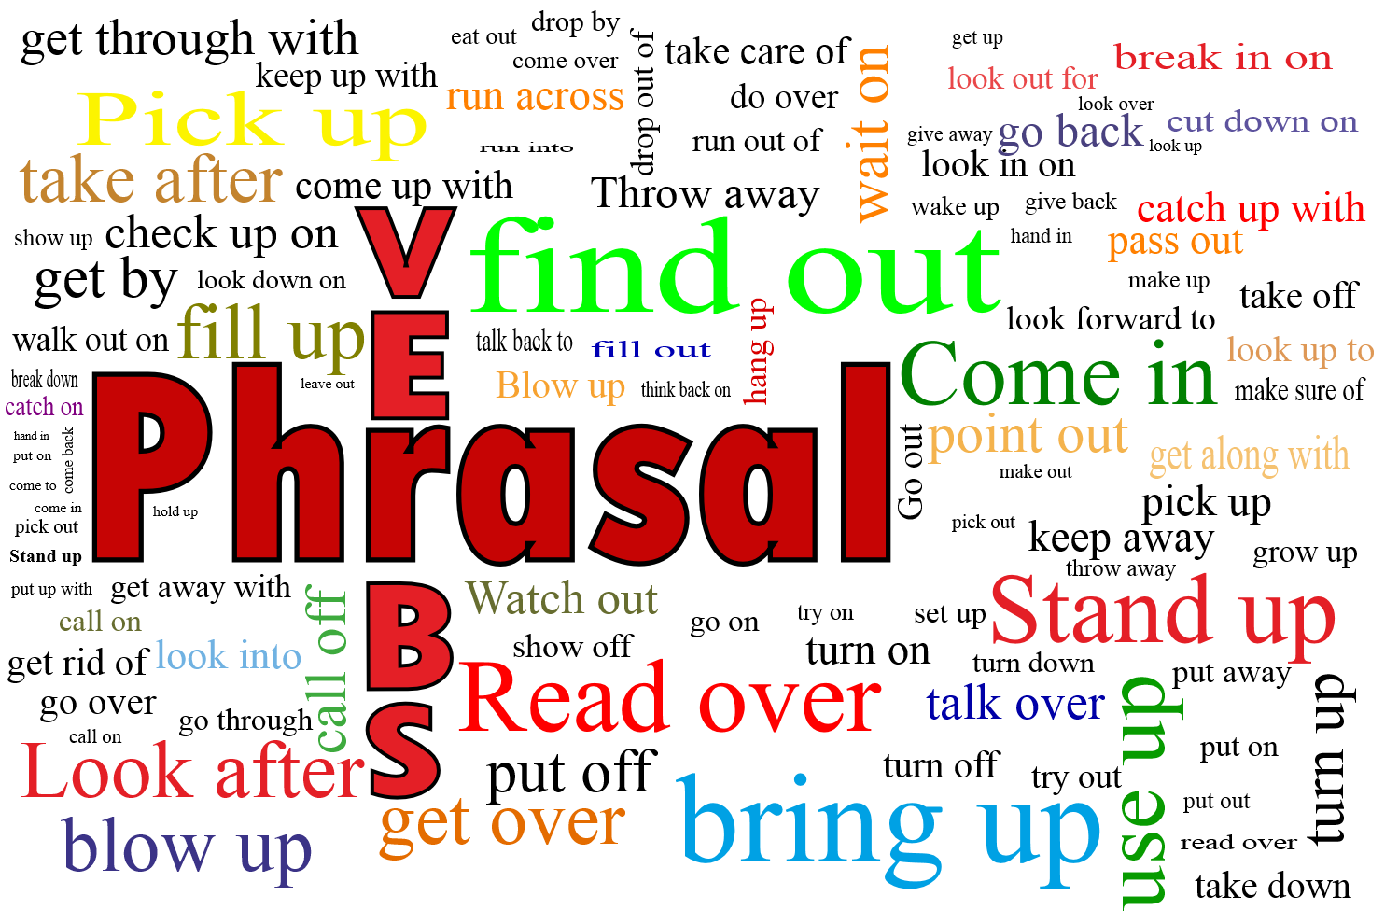

Slide 2



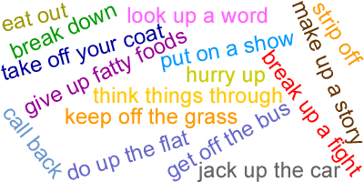
A Phrasal verb is the combination of two or three words from different grammatical categories — a verb and a particle, such as an adverb or a preposition — to form a single semantic unit on a lexical or syntactic level.

Slide 3
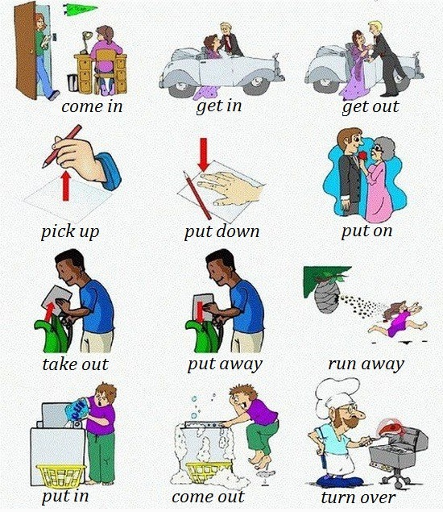

Slide 4
Poll Question
A phrasal verb is the combination of two or three words from different grammatical categories.
A. True
B. False

Slide 5
answer
Option- A

Slide 6
Why are phrasal verbs important?
Phrasal verbs are very common – they appear in all areas of English, from business English and academic English right the way through to informal, spoken English.
Using phrasal verbs correctly makes your English sound natural and fluent and they occur so frequently in English that students need to master them if they are ever going to progress

Slide 7

Be aware that one of the special features of phrasal verbs is that some of them have many different meanings
For example,
you can pick something up from the floor, you can pick up a language or bad habits, the weather can pick up, you can pick up a bargain, a radio can pick up a signal, the economy can pick up, you can pick up a story where you left it, you can pick someone up in your car. Sometimes the meanings are clearly related, some being more literal and some more metaphorical.

Slide 8
Poll Question
Do the phrasal verbs have different meaning in the different contexts?
A. True
B. False

Slide 9
answer
Option- A

Slide 10
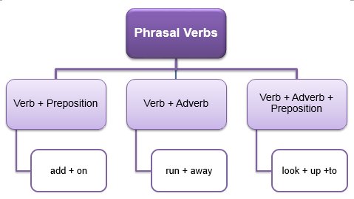

Slide 11
Poll Question
Which of the following is not a type of phrasal verb ?
A. Verb+ adverb
B. Verb + preposition
C. Verb+ conjunction
D. Verb + adverb+ preposition

Slide 12
Answer
Option- c

Slide 13
Phrasal verb: VERB + PREPOSITION
This type of phrasal verb is also called a "prepositional verb".
Because a preposition always has an object, all prepositional verbs have direct objects (i.e they are transitive).
prepositional verb | meaning | example sentence
 |  |  | direct object
believe in | have faith in the existence of | I believe in | God.
look after | take care of | He is looking after | the dog.
talk about | discuss | Did you talk about | me?

Slide 14
Phrasal verb: VERB +ADVERB
Phrasal Verb | Meaning | Example sentence
Look up | search for and find information in a reference book | You can look up the word in a dictionary.
Break down | Stop working | Our car broke down at the side of the highway in the snowstorm.

Slide 15
Phrasal verb: VERB + ADVERB + PREPOSITION
This type of phrasal verb is also called a "phrasal-prepositional verb". Look at these examples of phrasal-prepositional verbs:
phrasal-prepositional verb | meaning | example sentence
 |  |  | direct object
get on with | have a friendly relationship with | He doesn't get on with | his wife.
put up with | tolerate | I won't put up with | your attitude.
look forward to | anticipate with pleasure | I look forward to | seeing you.
run out of | use up, exhaust | We have run out of | eggs.

Slide 16
I ______________ seeing my friends again.
A. Look forward to
B. Put up with
C. Keep up
D. Carried away

Slide 17
Answer
OPTION- A

Slide 18
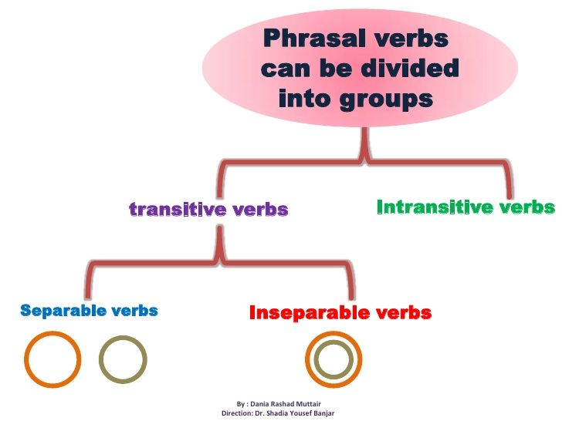

Slide 19
transitive (direct object) intransitive (no direct object)
 |  | Meaning | Example sentence | Direct object
Transitive | put off | postpone | We will have to put off | the meeting.
 | turn down | refuse | They turned down | my offer.
Intransitive | get up | rise from bed | I don't like to get up. | N.A
 | break down | stop working | He was late because his car broke down. | N.A

Slide 20
Poll Question
A transitive verb does not take a direct object.
True
False

Slide 21
answer
Option- b

Slide 22
Some verbs can be used both with and without an object, but the meaning may change. Use the context to decide if the verb has a different meaning from the one you are familiar with.
Examples:
Tina and Jo were so clever the teacher moved them up to a higher class. (With object) tina and jo moved up to a higher class. (No object = same meaning)
I can drop you off at the station. (With object = drive you somewhere and leave you there)
I was sitting in the armchair and I dropped off.(No object = fell asleep, different meaning)

Slide 23
POSITION OF THE OBJECT
When VERB + ADVERB type of phrasal verb has a direct object, we can usually separate the two parts. For example, "turn down" is separable. We can say: "turn down my offer" or "turn my offer down". Look at these example sentences:
They turned down my offer.
They turned my offer down.

Slide 24
However, if the direct object is a pronoun, we have no choice. We must separate the two parts of the verb and insert the pronoun. Look at these examples with the verb "switch on". Note that the last one is impossible:
John switched on the radio.
John switched the radio on.
John switched it on.
X John switched on it.

Slide 25
Poll Question
Phrasal verbs CAN be separated?
A. yes
B. no

Slide 26
Answer
Option- b

Slide 27

POSITION OF THE OBJECT VERB + PREPOSITION
Prepositional verbs cannot be separated. That means that we cannot put the direct object between the two parts.
For example, we must say "look after the baby". We cannot say "look the baby after":
Who is looking after the baby?
X Who is looking the baby after?

Slide 28
Poll Question
Which of the following is a correct sentence?
A. Ria switched on the light.
B. Ria switched the light on.

Slide 29
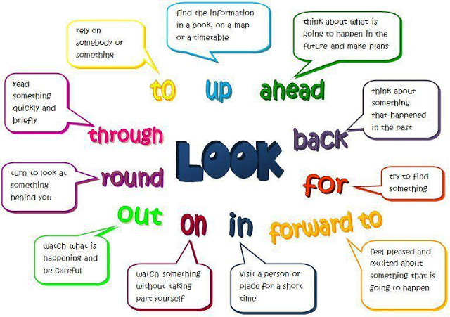

Slide 30
Poll Question
What is the meaning of the phrasal verb ‘look through’ ?
A. Think about something that happened in the past
B. Visit a person or a place for short time
C. Read something quickly and briefly
D. Rely on somebody

Slide 31
Answer
Option- c

Slide 32
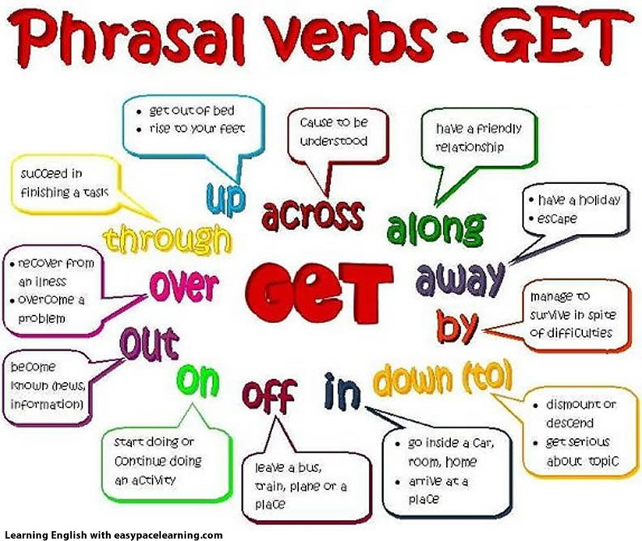

Slide 33
Poll question
Which of the following phrasal verb means- manage to survive in spite of difficulties.
A. Get on
B. Get by
C. Get off
D. Get in

Slide 34
Answer
Option- b

Slide 35


Slide 36
Which of the following is not a phrasal verb ?
A. come over
B. come through
C. come off
D. come enjoy

Slide 37
answer
Option- d

Slide 38
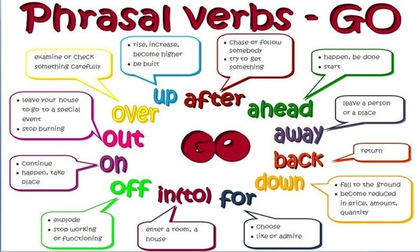

Slide 39
Activity- Make a student presenter to match the given columns
Go on | Examine or check carefully
Go over | Leave your house to go to a special event
Go after | Continue
Go out | Chase or follow somebody

Slide 40


Slide 41
Poll question
Which of the following phrasal verb means- relieve something temporarily
A. Take off
B. Take over
C. Take out
D. Take in

Slide 42
answer
Option- a

Slide 43


Slide 44
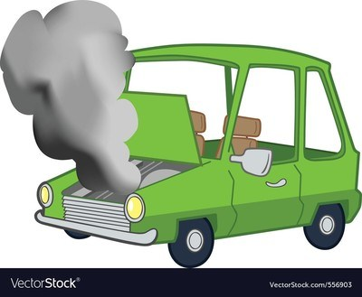
Poll Question
Choose what best defines the picture.
A. Break up
B. Break down
C. Break in
D. Break out

Slide 45
Answer
OPTION- B

Slide 46
“Practice is just as valuable as a sale. The sale will make you a living; the skill will make you a fortune.”
Thank you

